Slide 1

RUNGTA COLLEGE OF DENTAL SCIENCES AND RESEARCH
MALABSORPTION SYNDROME
DEPARTMENT OF GENERAL MEDICINE

Slide 2
SPECIFIC LEARNING OBJECTIVES
MUST KNOW | NICE TO KNOW | DESIRE TO KNOW
MECHANISM | INVESTIGATIONS | POSTGASTRECTOMY MALABSORPTION
CAUSES | PATHOPHYSIOLOGY | INTESTINAL LYMPHOMA
CLINICAL FEATURES | INTESTINAL TUBERCULOSIS | PROTEIN LOSING ENTEROPATHY
SIGN AND SYMPTOM |  | SHORT BOWEL SYNDROME

Slide 3
CONTENTS
MECHANISM
CAUSES
CLINICAL FEATURES
SIGN AND SYMPTOMS
INVESTIGATIONS
PATHOPHYSIOLOGY
POSTGASTRECTOMY MALABSORPTION
INTESTINAL LYMPHOMA
PROTEIN LOSING ENTEROPATHY
INTESTINAL TUBERCULOSIS
SHORT BOWEL SYNDROME
SUMMARY

Slide 4
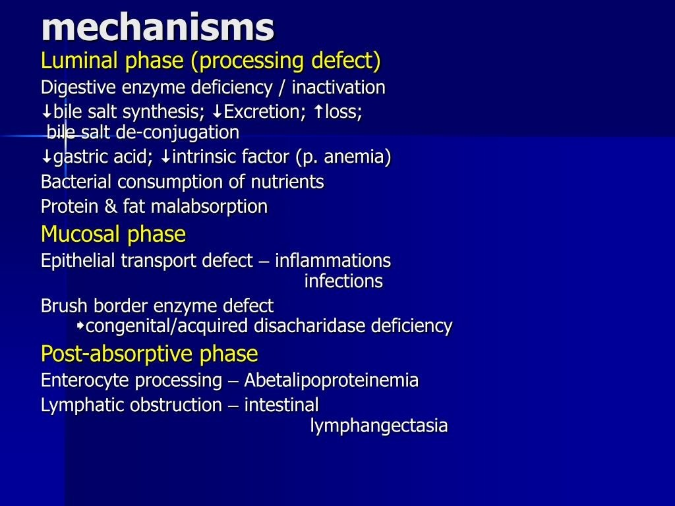

Slide 5
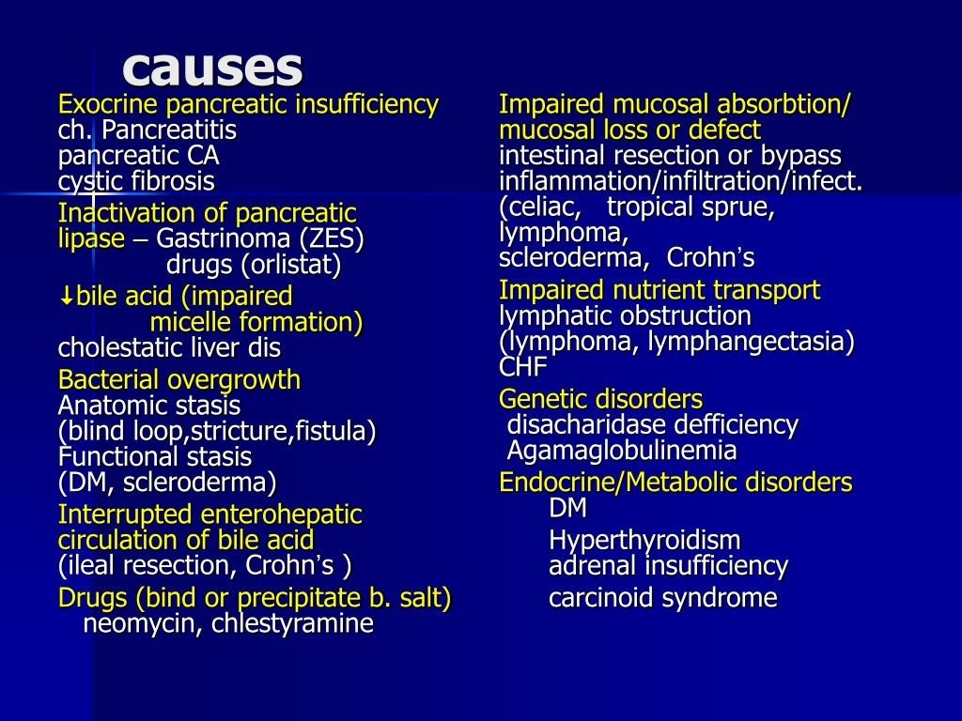

Slide 6
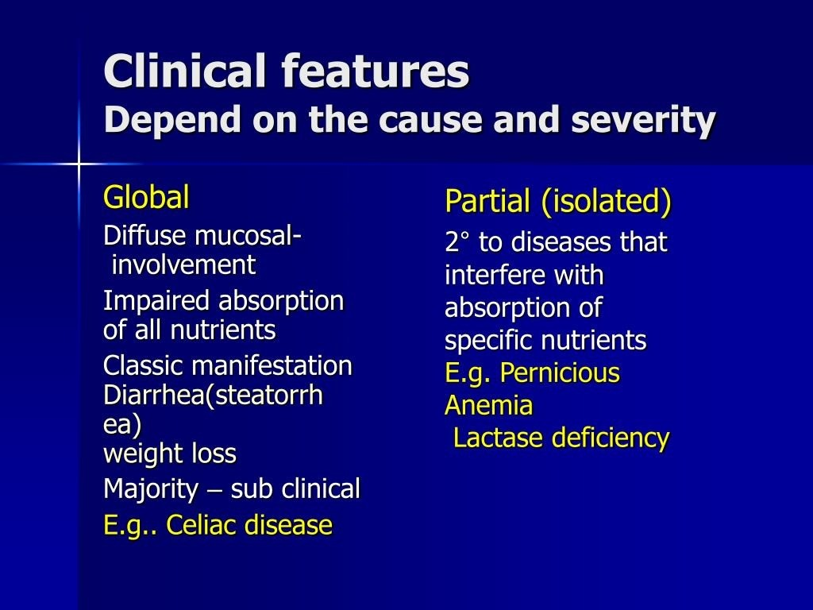

Slide 7
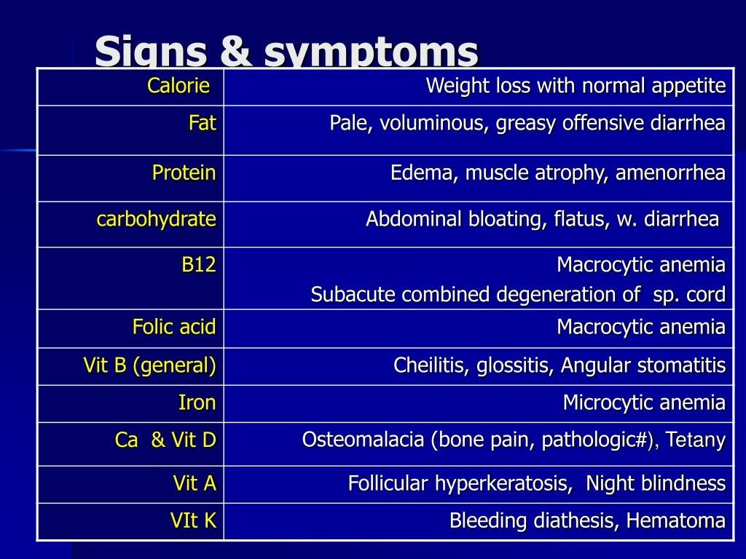

Slide 8
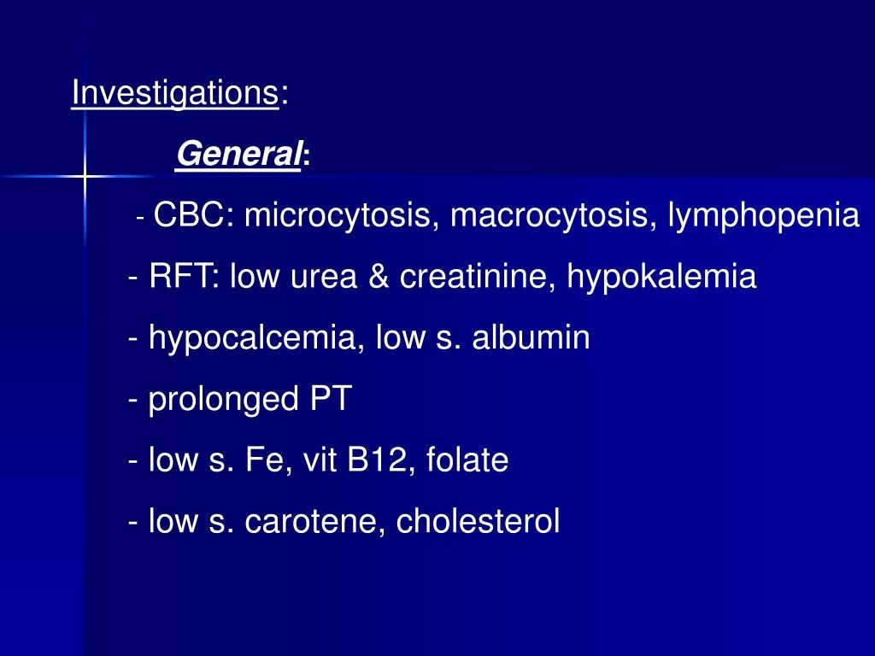

Slide 9
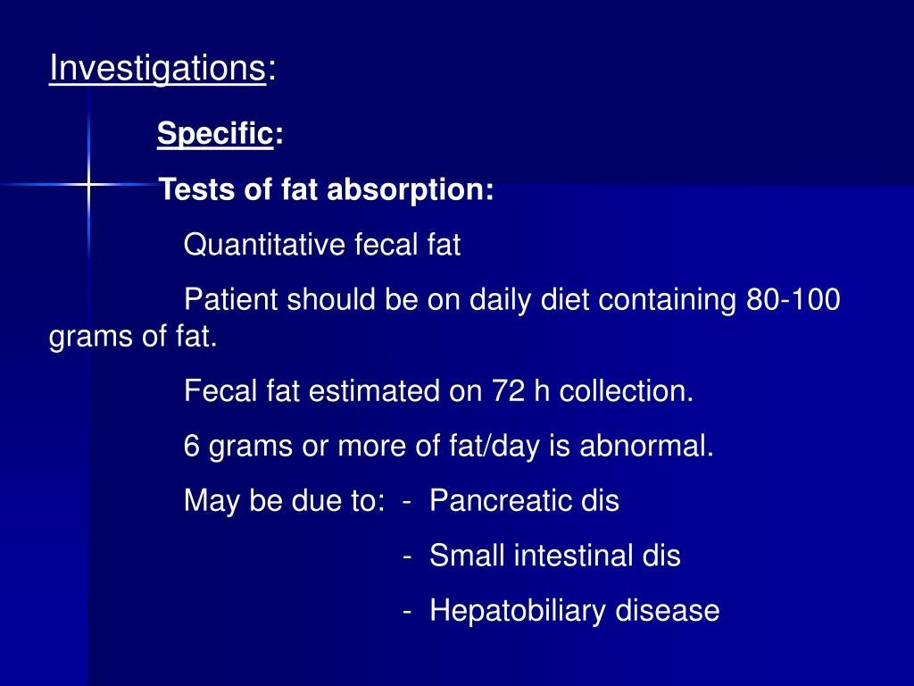

Slide 10
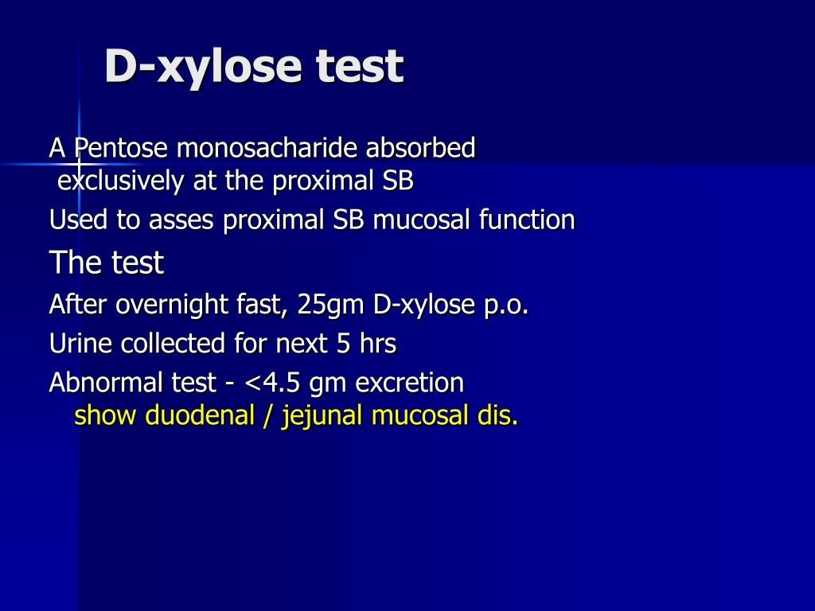

Slide 11
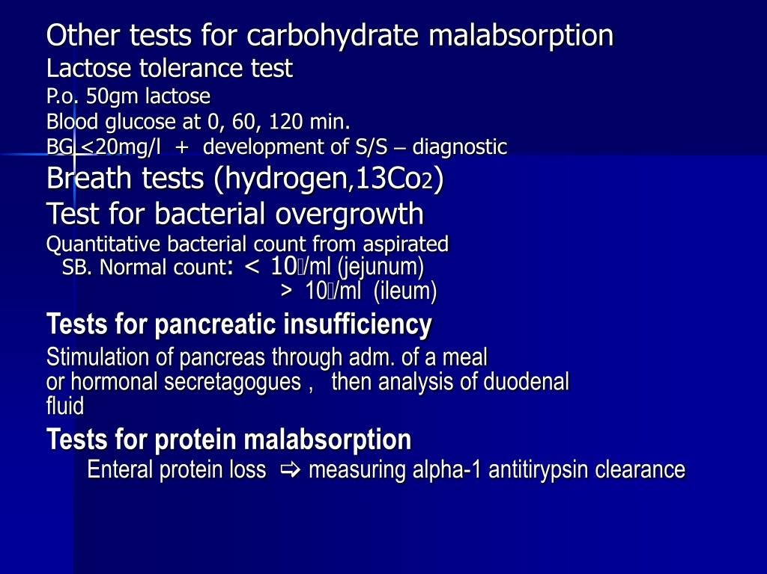

Slide 12
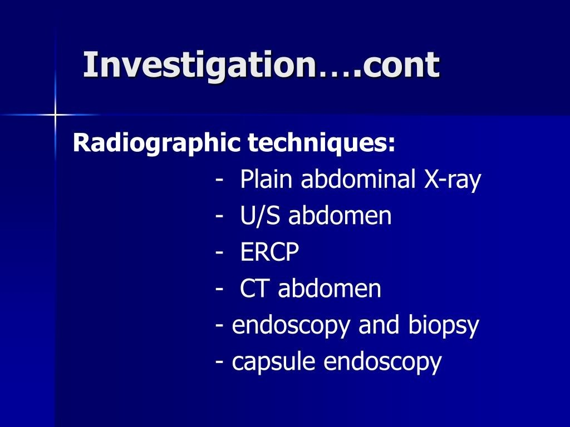

Slide 13
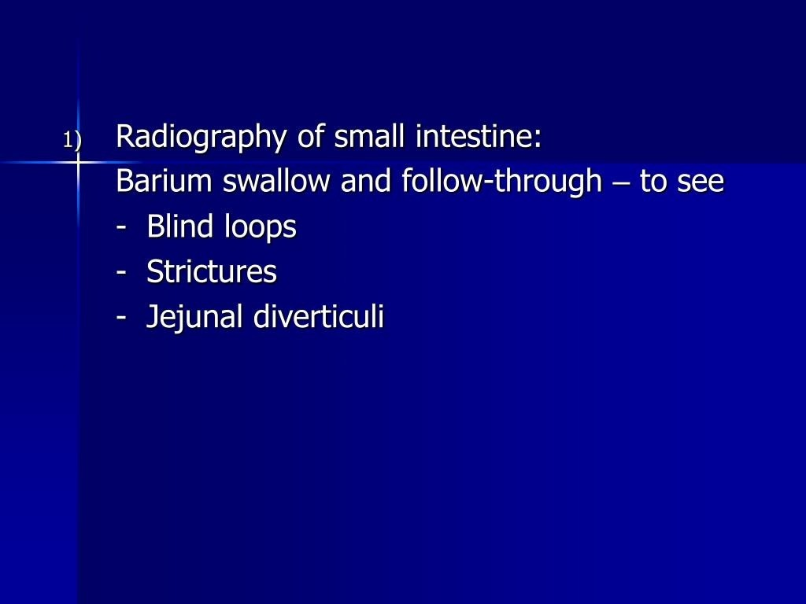

Slide 14
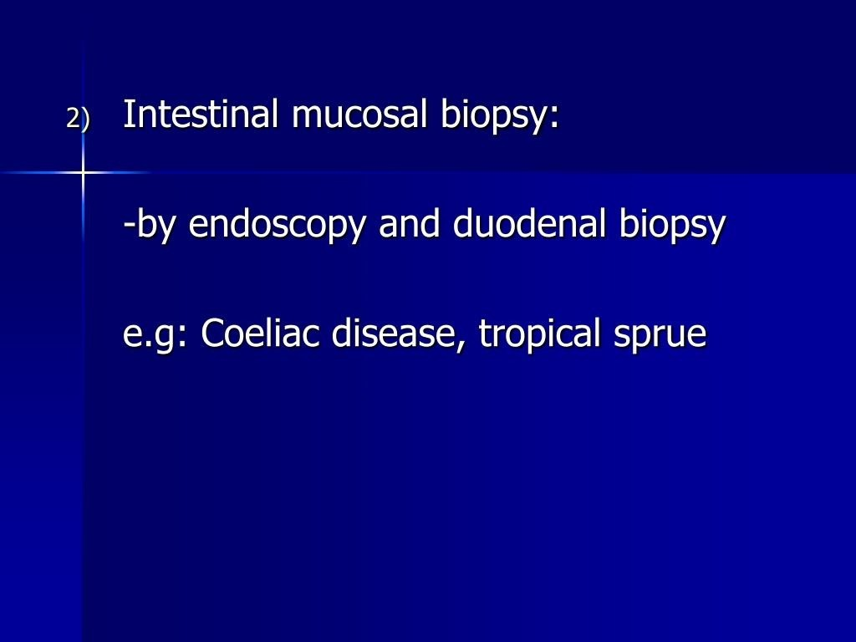

Slide 15
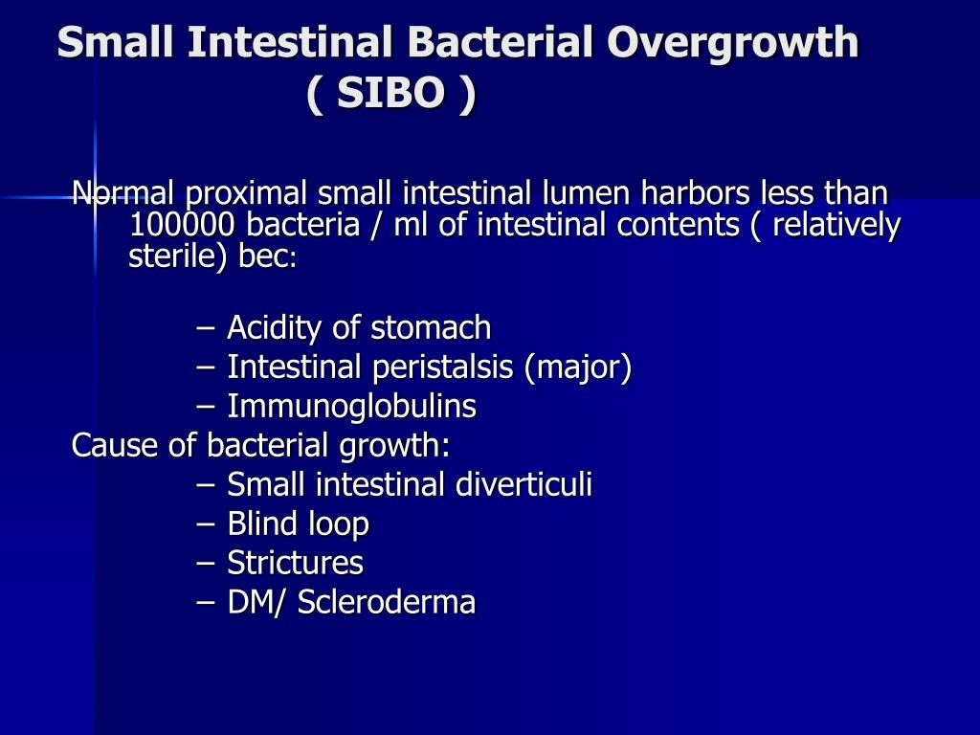

Slide 16
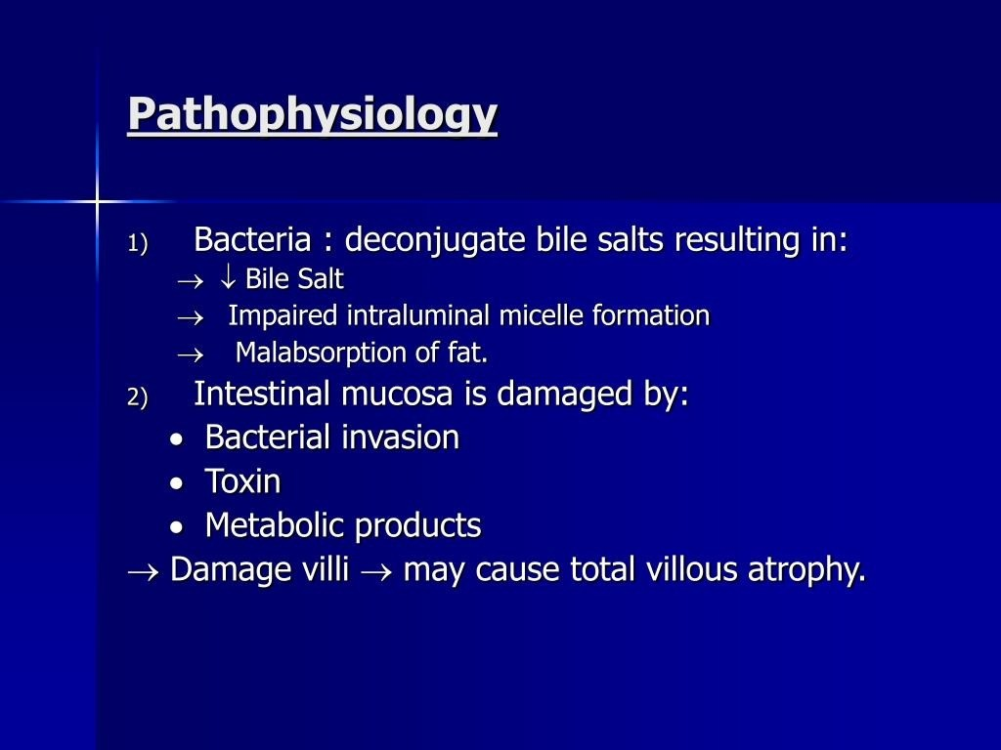

Slide 17
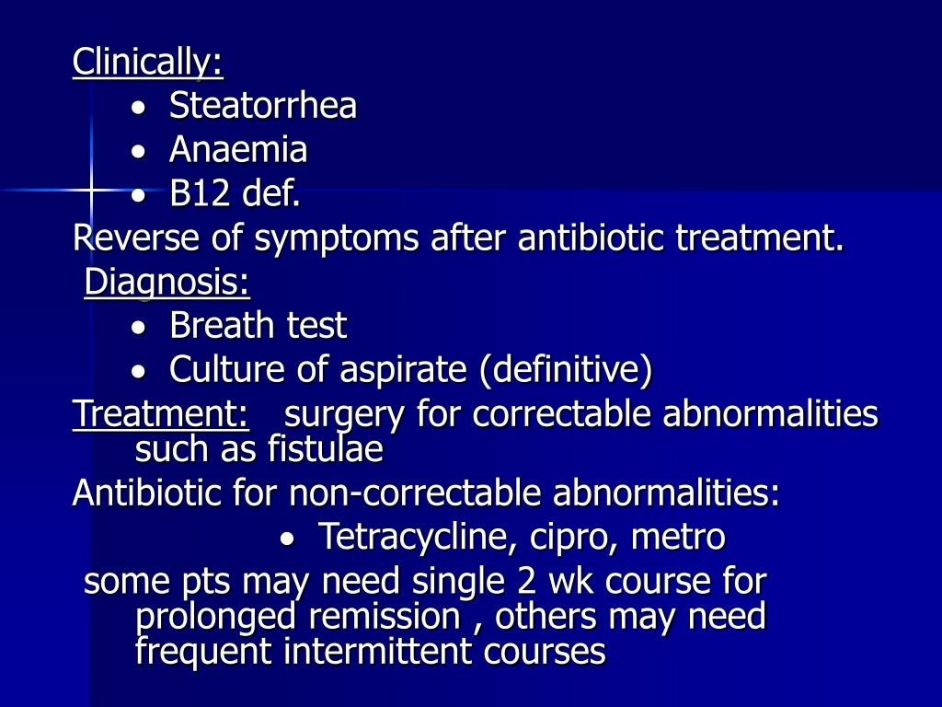

Slide 18
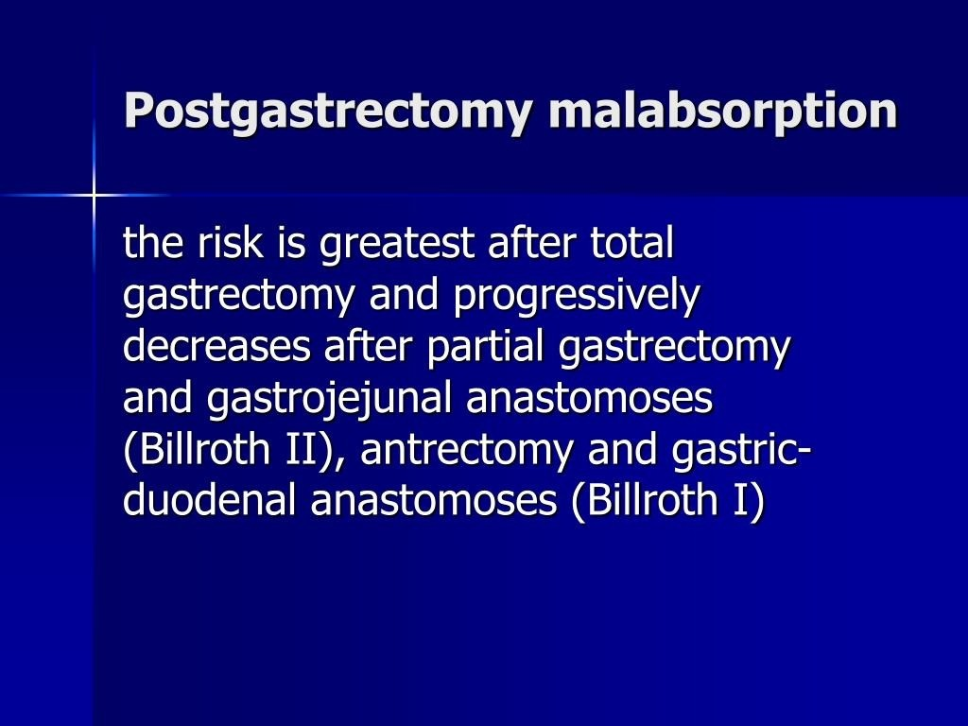

Slide 19
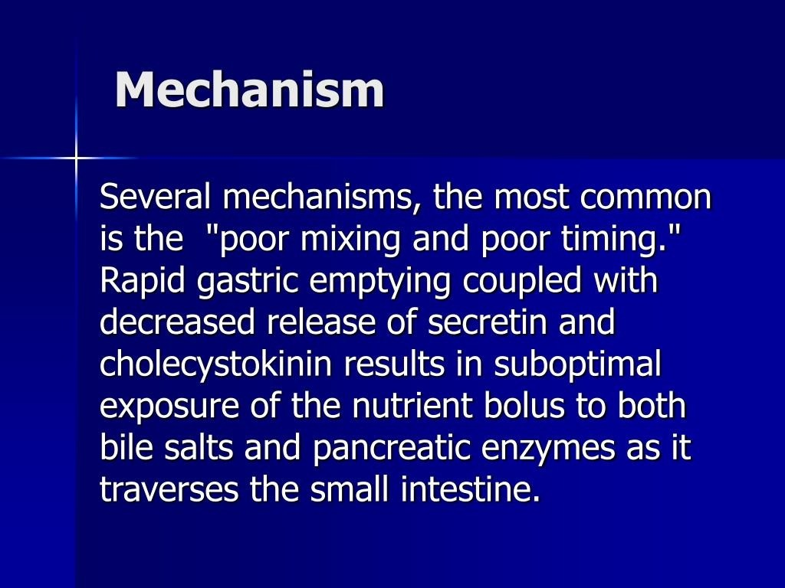

Slide 20
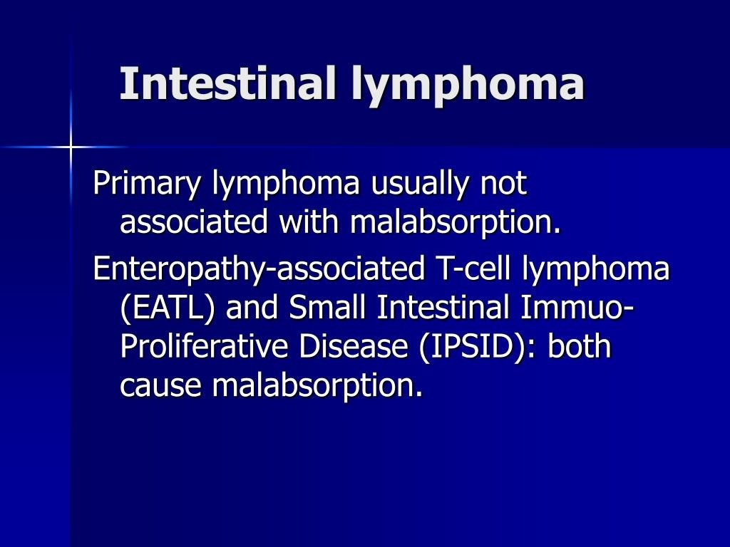

Slide 21
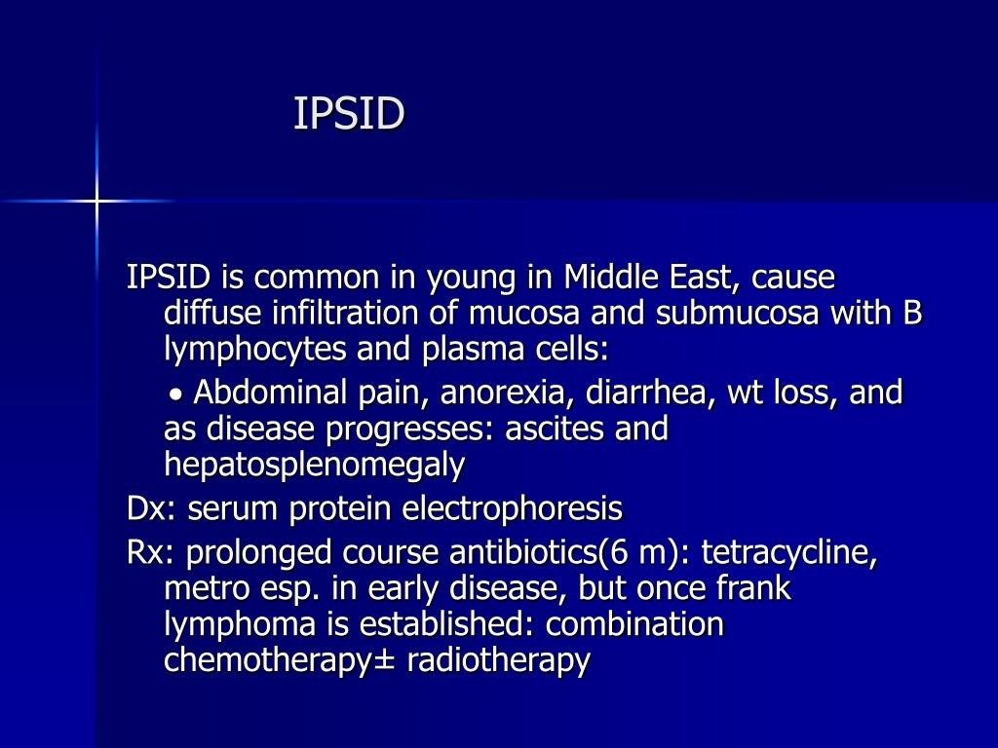

Slide 22
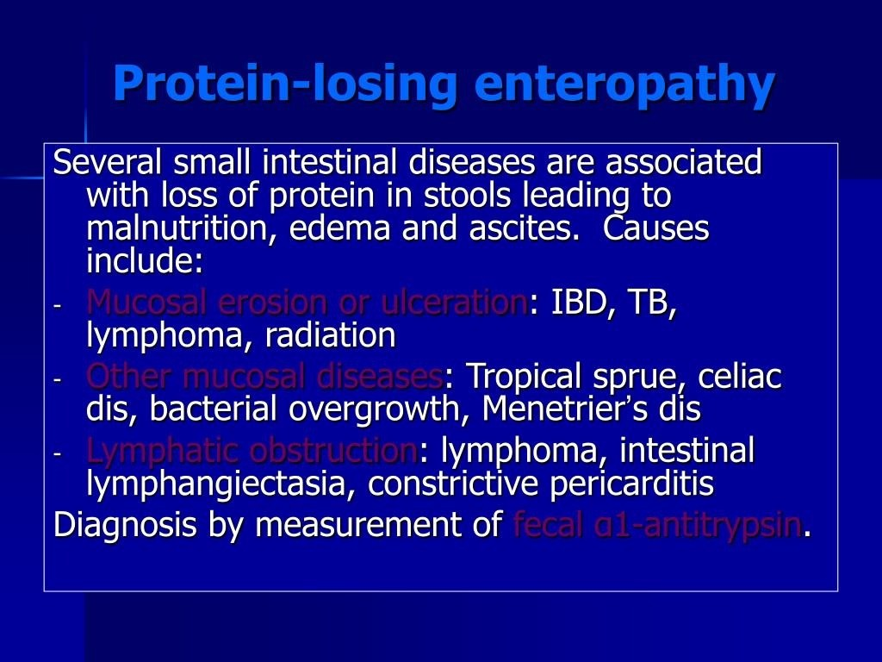

Slide 23
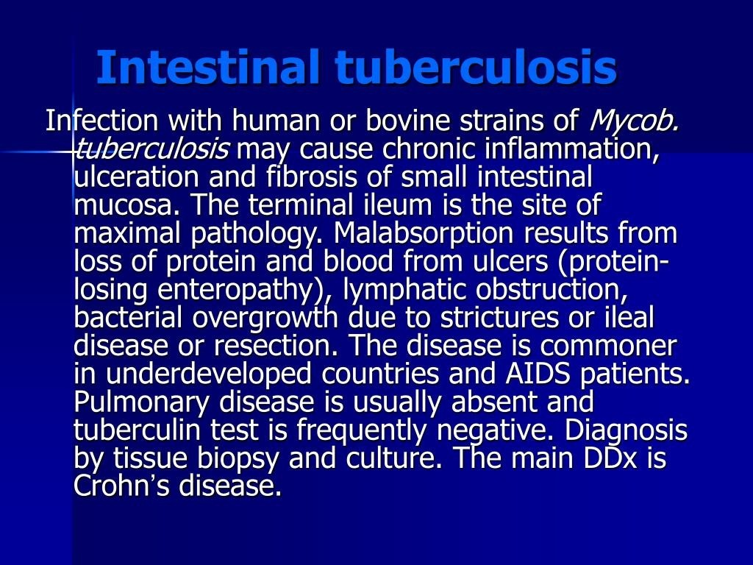

Slide 24
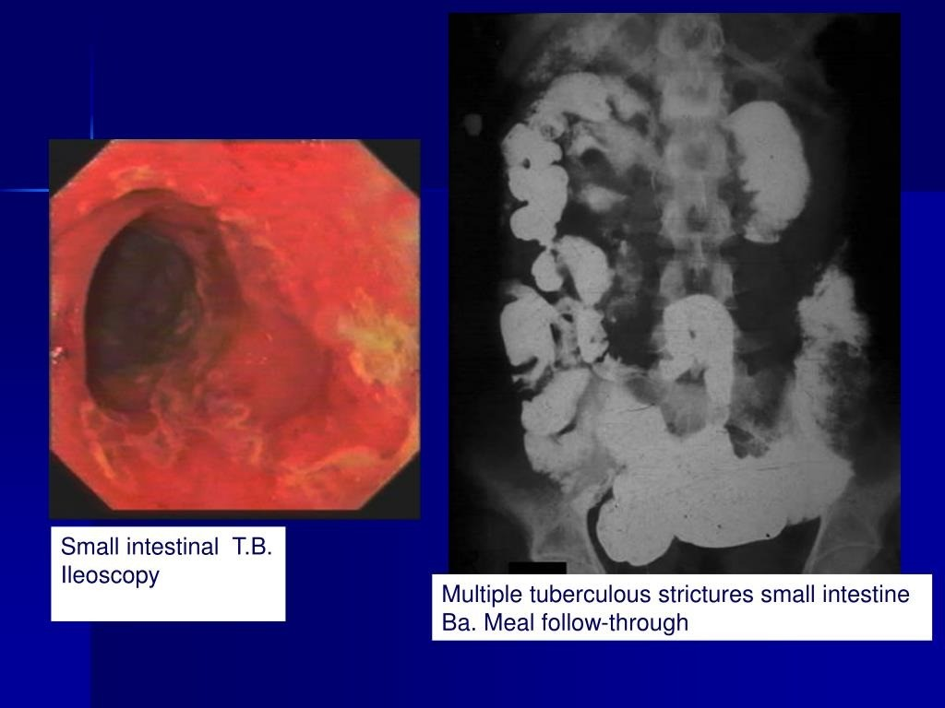

Slide 25
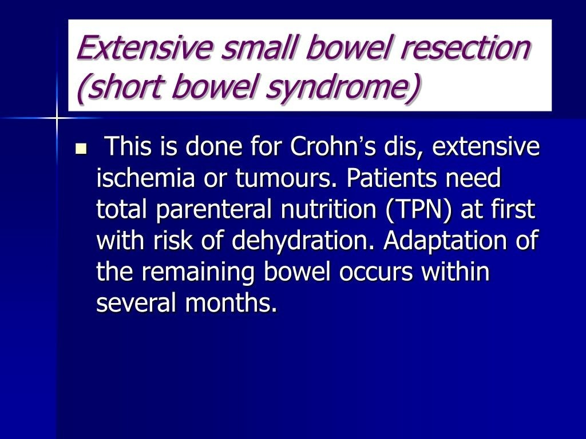

Slide 26
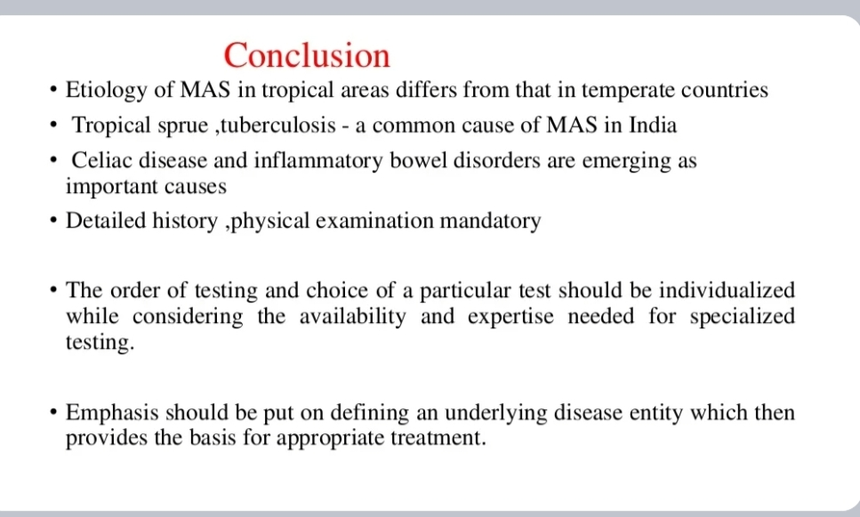

Slide 27
REFERENCES
DAVIDSON’S PRINCIPLES AND PRACTICE OF MEDICINE; 23rd edition
HARRISON’S PRINCIPLE OF INTERNAL MEDICINE; 21ST edition
TEXTBOOK OF CLINICAL MEDICINE by S.N Chugh ;5th edition

Slide 28
QUESTION AND ANSWERS

Slide 29
THANK YOU....

